Slide 1
Graph Transformer GAN:
Data Augmentation of Brain Connectivity for dementia classification
Yikang Li 2022/4/8

Slide 2

Overview
Alzheimer’s disease (AD) is the most common age-related dementia, which significantly affects an individual’s daily life and impact socioeconomics. It remains a challenge to identify the individuals at risk of dementia for precise management. Brain MRI offers a non invasive biomarker to detect brain aging. However, the limited availability of diffusion MRI challenges the model training of deep learning. In this case, we propose the Graph Transformer GAN, a variant of the generative adversarial network, to efficiently augment the structural brain networks for dementia classifying tasks. The Graph Transformer GAN model is trained to generate fake brain connectivity matrices, which are expected to reflect the latent distribution and topological features of the real brain network data. Moreover, Graph Transformer layer, as the core of the Graph Transformer GAN is capable for generating new useful multi-hop connections between unconnected nodes. Those multi-hop connections, named meta-paths, can identify the pathological regions of the Alzheimer’s disease.

Slide 3
Problems to solve
As one of the most common disease, Alzheimer’s disease (AD) have significantly impact on patients’ cognitive performance and socioeconomic status. For curing this disease, numerous classification tasks are essential.
Although the Synthetic Minority Oversampling Technique(SMOTE) and Adaptive Synthetic Sampling (ADASYN) are also widely used, their KNN-assisted techniques have been proved less effective for capturing the topological features.
1
3
2
Although the deep learning approach have been proved useful for finishing the classification tasks, the limited of Alzheimer’s disease(AD) datasets also restricted the development of deep learning methods.
4
We have proved that standard generative adversarial networks can also be used to finish the data augmentation tasks. However, the multilayer perceptron(MLP) generator took a long time for training, and it may less sensitive for the structure of the connectivity matrix.

Slide 4
Proposed solution
Using GAN to generate more data with balanced labels. Seting the graph transformer network as the generator to effectively capture the latent structural features of Brain connectivity.

Slide 5
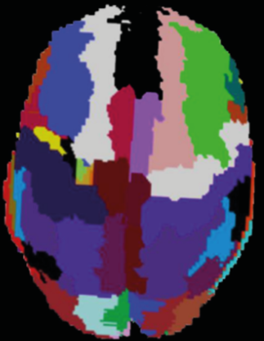
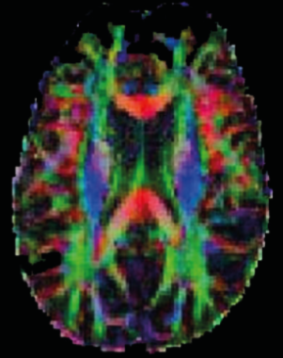
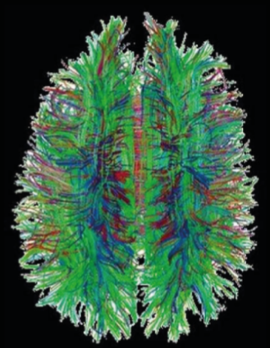
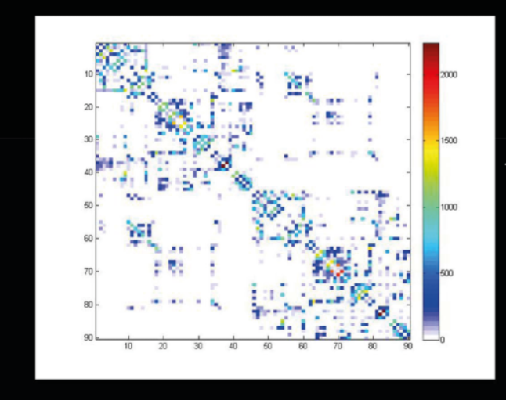
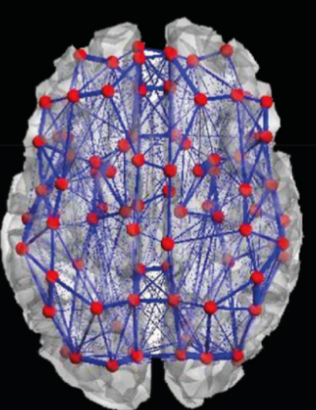
Data Preprocessing
Brain
Parcellation
Diffusion
Brain
Imaging
1. dMRI was pre-processed in the FSL (FMRIB software library).
2. Tractography was performed on the processed dMRI using the Diffusion Toolkit.
3. The grey matter regions of dMRI were divided into 90 brain regions using the Automated Anatomical Labelling (AAL) atlas.
4. The structural brain networks were constructed by counting the number of tracts between each pair of brain regions to produce an adjacency matrix.
5. The tract counts of the brain network were normalized to between 0 and 1.
Brain
Tractography
Brain
Graph
Connectivity Matrix

Slide 6
Work Flow of Graph Transformer GAN
real(X|C)
Discriminator(GNN)
real(X|C)
Generator(GTN)
fake(X’|C)
Classifier(GNN)
The graph transformer GAN consists of three parts, generator, discriminator and classifier. The generator is generating the fake connectivity matrix based on the input real connectivity matrix. The main architecture of generator is Graph Transformer Networks. The discriminator is implemented to quantify the distance between real and fake data. W-loss is applied for discriminator optimization. The classifier is implemented to perform the binary classification(AD/CN). BCEwith logits loss was applied for discriminator optimization. The main architecture of both discriminator and classifer is BrainNet CNN.

Slide 7
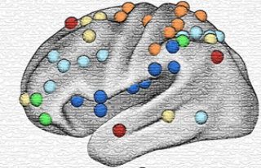
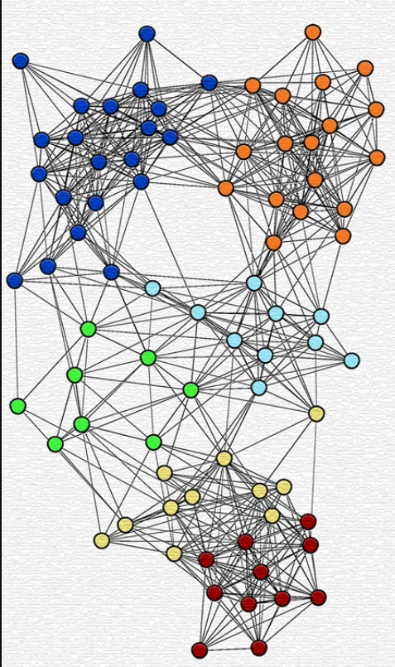
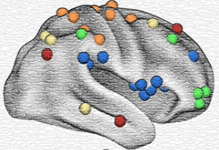
GTN(Graph Transformer Networks)
Graph Transformer Layer softly selects adjacency matrices (node types) from the set of adjacency matrices A of brain graph G based on the atlas regions. Then it learns a new meta-path graph represented by A(1) via the matrix multiplication of two selected adjacency matrices Q1 and Q2. The soft adjacency matrix selection is a weighted sum of candidate adjacency matrices obtained by 1 × 1 convolutionwith non-negative weights from softmax weight W₁ and W₂ .
_{W1}
1 x1 Conv
Q 1
softmax
A⁽¹⁾
softmax
W₂
1 x1 Conv
Q 2

Slide 8
Project Difficulties
01 | Data manipulation Problem: GTN is mainly implemented for heterogenous graph. Although we could also set the connections between the connections between different brain regions as the input. It is really hard to normalize all the input data.
02 | Limited Amount of Datasets: The previous work used 600 graphs as the training dataset. We only have 202 graphs in total. Since we are directly generating the fake, we may not need 600 graphs for the training input. But it still may not enough to optimize the model.
03 | Explanation of AI interpretability: Although the model can effectively provide the insight on adaptive meta-paths , we still have to manually set the meta-paths for comparison.
04 | Limited previous work as reference: Since we wish to use the automatic generated meta-paths to demonstrate the pathological regions of the AD, there is not too much previous work can be reference.

Slide 9
Proposed Process
Data Manipulation Done
Neurips 2022 Submission
First draft of TMI journal Submission
Code part of an conference paper done
Report Submission
Finishing the code part of the data manipulation. Finishing the task of handling the data that can be processed for the neural network.
Finishing the literature part and submit the paper to Neurips 2022 conference.
Finishing the task of adding contrasitive learning and AI explanability to this project. Try to submit the journal paper for review.
May 6th
June 1st
April 22th
May 16th
July 1st
Finishing all the code part i.e. adding the specific attention block to the original GAN.
Submitting the report to Imperial College London system (Cate). It should contains all the background knowledge and work done in this period.

Slide 10
Thank you.

